Slide 1

RUNGTA COLLEGE OF DENTAL SCIENCES & RESEARCH
TITLE OF THE TOPIC: ENDODONTIC EMERGENCY
DEPARTMENT OF CONSERVATIVE DENTISTRY AND ENDODONTICS

Slide 2
Specific learning Objectives
At the end of this presentation the learner is expected to know
Core areas* H | Domain ** | Category #
ENDODONTIC EMERGENCIES, DIAGNOSIS, | Cognitive | Must know
TREATMENT PLANNING, AVULSION, NaOCl accident | Psychomotor | Nice to know
Aapical extrusion of debris | Affective | Desire to know
*Subtopic of importance
** Cognitive, Psychomotor or Affective
# Must know , Nice to know & Desire to know

Slide 3
TABLE OF CONTENTS CONTENTS :
Introduction
Definition
Categories
Differentiation of Emergency and Urgency
System of Diagnosis

Slide 4
Treatment Planning
Pre-treatment Emergencies
Inter-appointment Emergencies
Post-obturation Emergencies
Emergencies related to trauma
Avulsion
Sodium hypochlorite accident
Conclusion
References

Slide 5
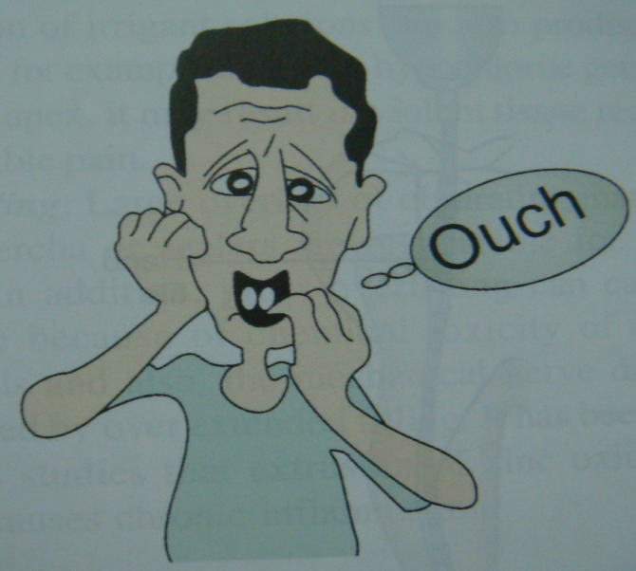
INTRODUCTION

Slide 6
DEFINITION:
endodontic emergencies are usually associated with pain and/or swelling and require immediate diagnosis and treatment
caused by
pathoses in the pulp or periradicular tissues
severe traumatic injuries - luxation, avulsion, or fractures of the hard tissues.

Slide 7
PAIN PERCEPTION
Chemical mediators
Pressure

Slide 8
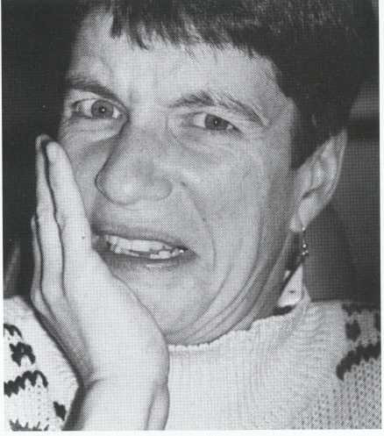
CATEGORIES :
Pre-treatment
Inter-appointment
Post-obturation
THE CHALLENGE

Slide 9
DIFFERENTIATION OF EMERGENCY
AND URGENCY
A true emergency is a condition requiring an unscheduled office visit with diagnosis and treatment now !

Slide 10
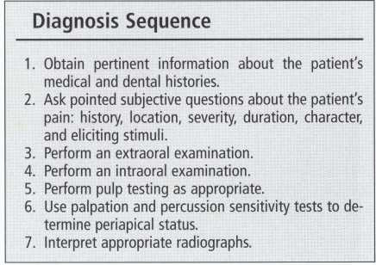
DEVELOPMENT OF A SYSTEM

Slide 11
System of diagnosis
Medical and dental histories
Subjective examination
Objective examination
Periodontal examination
Radiographic examination

Slide 12
Dental considerations
Stress reduction protocol
Maintain normal dietary habits
Schedule dental appointments earlier in the day
Use appropriate local anesthetics
Antibiotic coverage is recommended
Treatment planning
Patient management

Slide 13
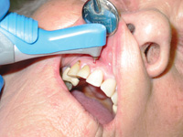
TREATMENT PLANNING
1.PRETREATMENT EMERGENCIES
These emergencies require a
DIAGNOSIS AND TREATMENT SEQUENCING
PATIENT MANAGEMENT
PROFOUND ANESTHESIA

Slide 14

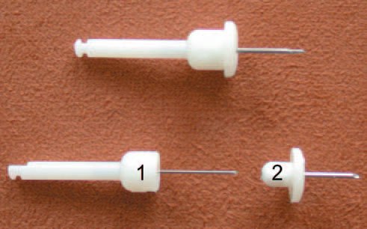
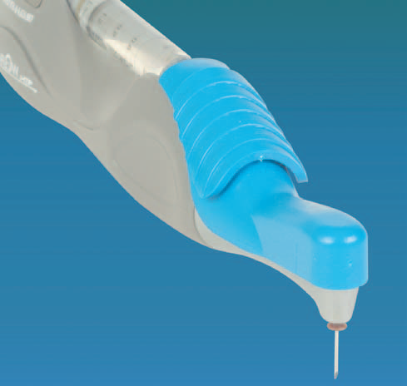
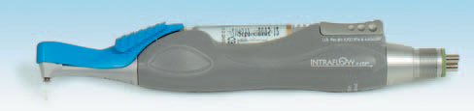
how can a clinician achieve profound anesthesia in a patient with irreversible pulpitis prior to beginning the procedure?
Three types of intraosseous anesthesia that are presently available
Stabident
X-tip™
Intraflow HTP Anesthesia System

Slide 15
What is the best approach to achieve anesthesia of a hot tooth?
Bigby et al., -
supplemental IOI of 4% articaine improves the anesthetic efficacy of the IAN block in mandibular posterior teeth with irreversible pulpitis
Cohen and others -
a supplemental PDL injection with 2% lidocaine -74% successful
Kanaa et al.,
4% articaine with 1:100,000 epinephrine was more effective

Slide 16
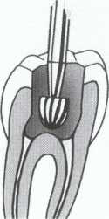
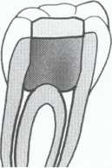
management of painful irreversible pulpitis
Without Acute Apical Periodontitis
Complete cleaning and shaping
Partial pulpectomy
pulpotomy

Slide 17
Acute pulpitis with apical periodontitis
A partial or total pulpectomy
Reducing the occlusion
management of pulp necrosis with apical pathosis
Treatment now is biphasic:
(1) remove or reduce the pulp irritants and
(2) relieve the apical fluid pressure

Slide 18
Pulp Necrosis Without Swelling
aim is to reduce the canal irritants and to try encourage some drainage through the tooth
Complete canal debridement, after determining
the corrected working length
canals are flooded and flushed with copious amounts of sodium hypochlorite
dried with paper points, filled with calcium hydroxide paste , and sealed with a dry cotton pellet and a temporary filling

Slide 19
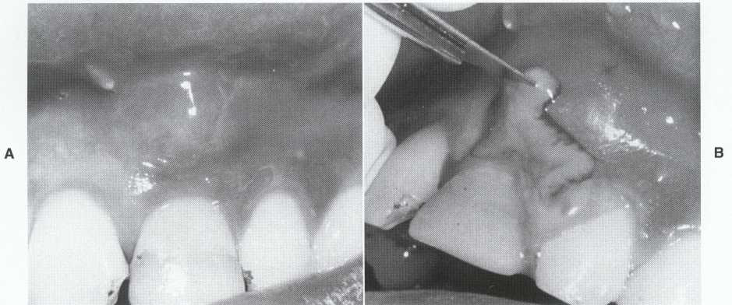
Pulp Necrosis with Localized Swelling

Slide 20

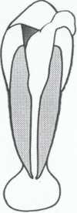

After opening into a root canal and establishment of
drainage, instrumentation should be confined to the root
canal system.
Release of purulence removes a potent irritant (pus) and relieves pressure

Slide 21
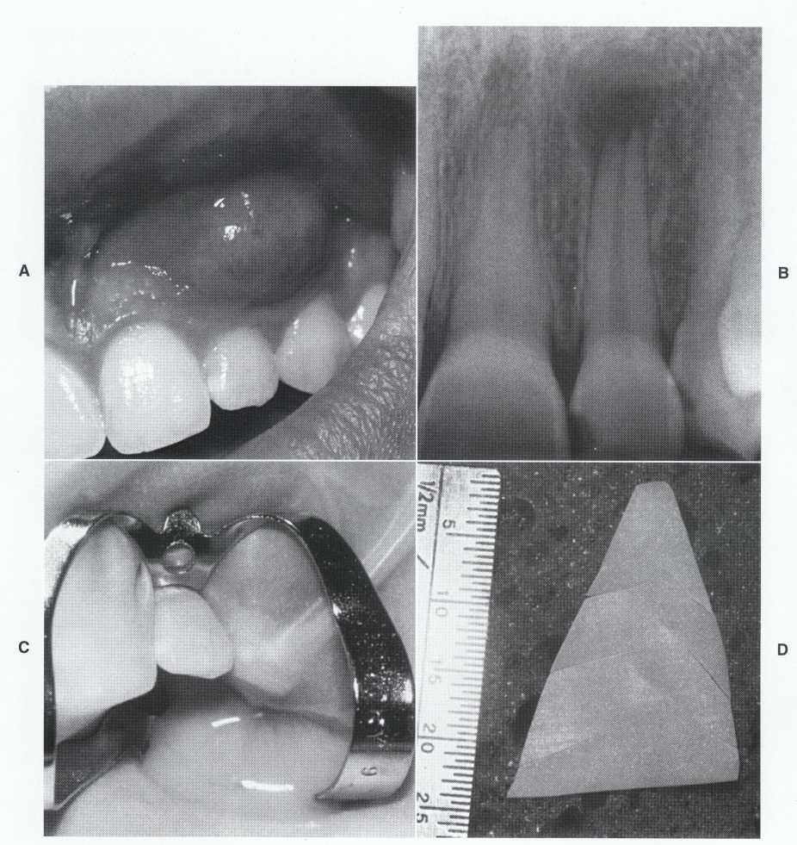
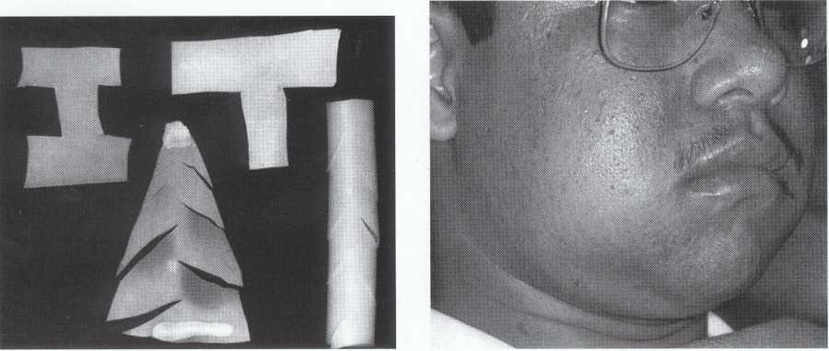

Slide 22
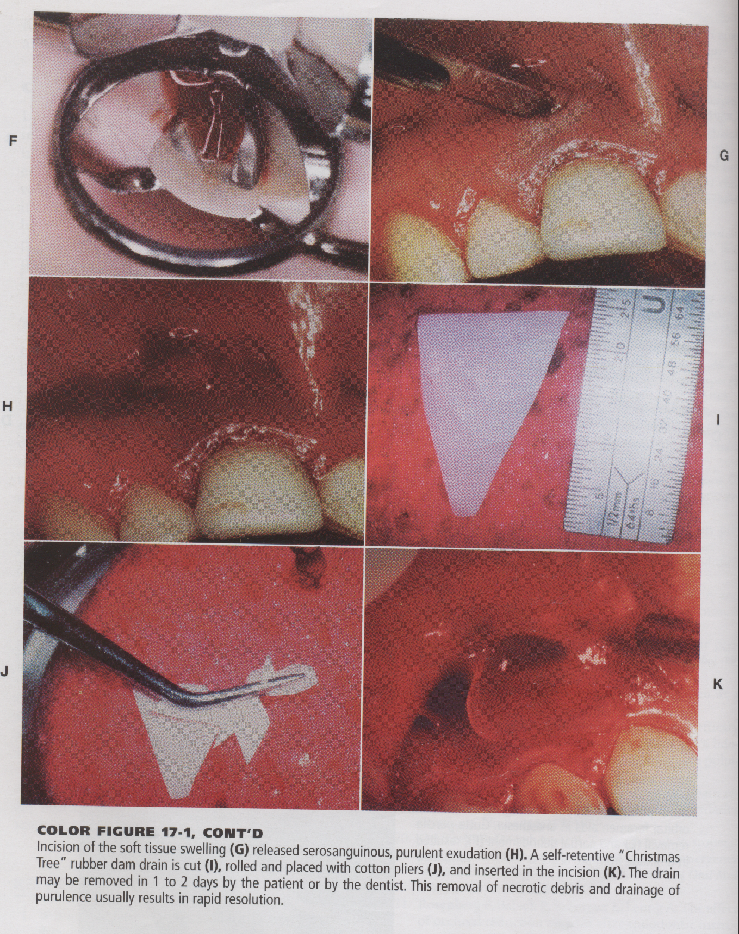

Slide 23
Pulp Necrosis with Diffuse Swelling
Localized treatment
extraction or pulp space debridement
incision for drainage
rubber drain inserted for 1 or 2 days
antibiotics
Progressively spreading swelling resulting from pulpal necrosis and acute apical abscess, rapidly into
the buccal space. This patient has systemic signs of infection

Slide 24
2.INTER-APPOINTMENT FLARE-UPS :
Flare-up – occurrence of pain, swelling or both during the course of root canal therapy , which results in unscheduled visits by patient
AAE – An acute exacerbation of periradicular pathosis after initiation or in continuation of a RCT.

Slide 25
Causative factors : ( Seltzer & Naidorf, 1985; Torabinejad et al 1988 )
Mechanical
Chemical
Microbial

Slide 26
Etiology :
Over- instrumentation
Inadequate debridement
Missed canal
Hyperocclusion
Debris Extrusion
Procedural complications

Slide 27
Microorganisms as causative agents of flare-ups :
Apical extrusion of infected debris
Changes in the endodontic micro biota & /or in environmental conditions
Secondary intra - radicular infections
Increase of the oxidation-reduction potential

Slide 28
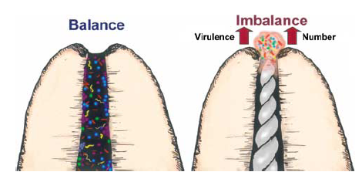
Apical extrusion of infected debris

Slide 29
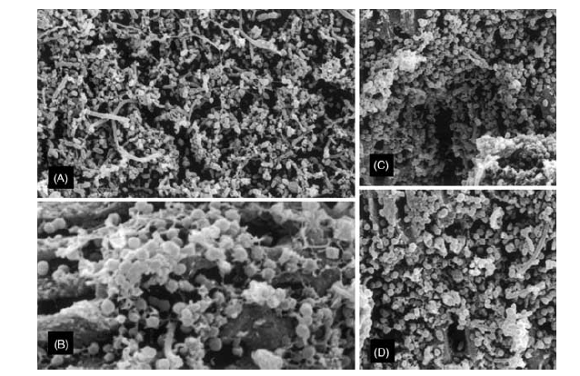

Changes in endodontic microbiota

Slide 30
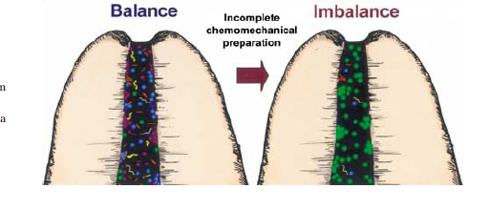
Incomplete chemo-mechanical preparation

Slide 31
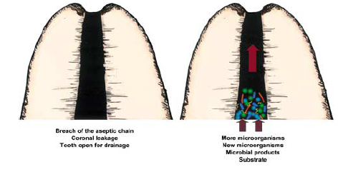
Secondary intra-radicular infections

Slide 32
Remnants of dental plaque,calculus,caries
Leaking rubber dam
Contamination of endodontic instruments
Leakage through temporary or permanent restoration
Fracture of tooth structure
Recurrent decay, delay in placement of permanent restoration

Slide 33
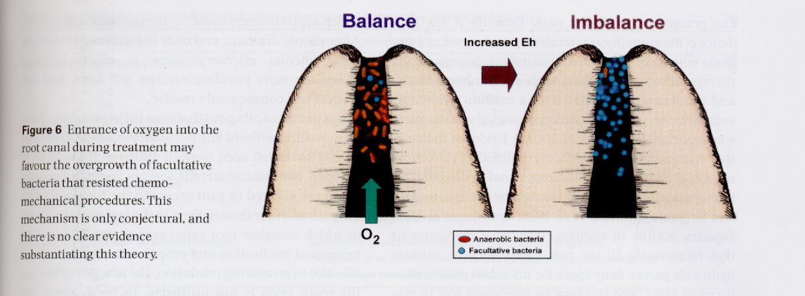
Increase of the oxidation-reduction potential

Slide 34
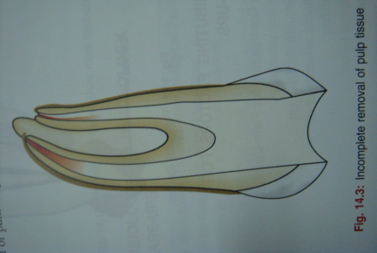
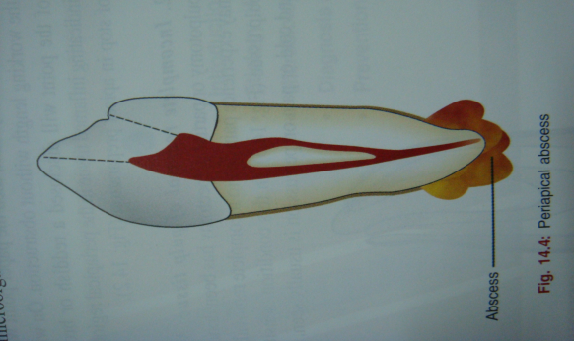
Clinical conditions :
Apical periodontitis
Incomplete removal of pulp tissue
Recrudescence of chronic apical periodontitis
Recurrent periapical abscess

Slide 35
Teaching Materials
Endodontic practices - Grossman
Pathways of pulp – Cohen
Textbook of Endodontics – Nisha Garg
Endodontics - Ingle

Slide 36
TAKE HOME MESSEGE/ FOR THE TOPIC COVERED (SUMMARY)
Endodontic emergencies are a challenge for both diagnosis and management.
Knowledge and skill in several aspects of endodontics are required;failure to apply these will result in serious consequences for the patient
It is satisfying and rewarding to successfully manage a distraught patient who has an emergency.

Slide 37
Question & Answer Session
1. Define and classify endodontic emergencies.

Slide 38
REFERENCES
Endodontic therapy- Franklin.S.Weine(sixth edition)
Principles and practice of endodontics-Walton, Torabinejad (4th Edition )
Traumatized teeth – Mitsuhiro Tsukiboshi
Iej-36,453-463,2003
Iej-38,843-848,2005
Oooe, vol.108, issue 1, July 2009, e46-e49
J Can Dent Assoc 2001; 67:391-7
J Am Dent Assoc, 2000, Vol 131, No 1, 67-71

Slide 39

THANK YOU

